Slide 1




Ana Fiona Dalipi - Baldwin Wallace University Shireen Khayat - University of Maryland, College Park Daniel Rodriguez-Lopez - Polytechnic University of Puerto Rico Deyaneira Torres-Gonzalez - University of Puerto Rico at Mayagüez Mentor: Dr. Timothy Peshek
Bio-Inspired Solar Electric Propulsion Investigation

Slide 2
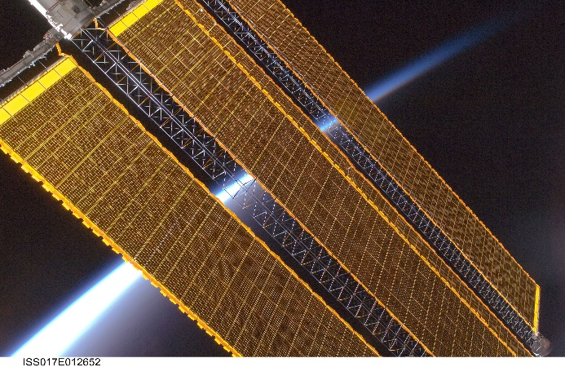
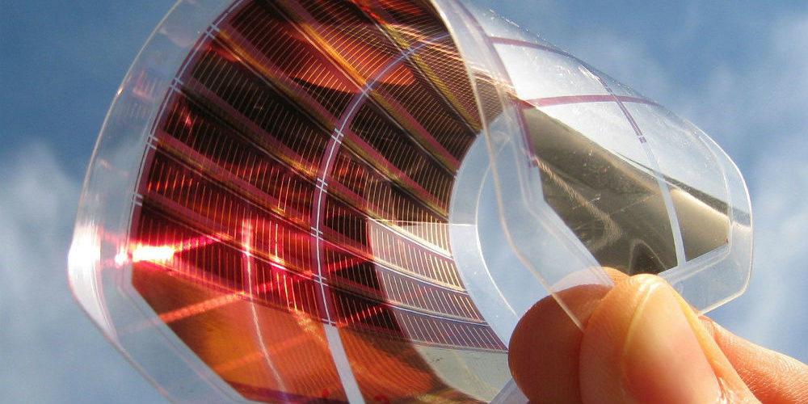


Introduction and Objective
1.
2.
Low Voltage
Subject to Arcing
More expensive
Difficult to manufacture
Heavy
Can sustain high voltage
Free of Arcing
Cheaper
Easier to manufacture
Lightweight
Notes:
30 sec
GaAs Cells suck bc
Perovskites are better bc
They do have one fault though, they are extremely water sensitive
Because there is no water in space, it is the ideal place to use them, but we have to survive take off first.
Kauderer, A. (2008, August 4). ISS017-E-012652 [Earth's horizon and station solar array panels are featured in this image photographed by an Expedition 17 crewmember on the International Space Station.]. Retrieved from https://spaceflight.nasa.gov/gallery/images/station/crew-17/html/iss017e012652.html
Solartek. (2017). [Perovskites]. Retrieved from http://sollartek.com/projects/perovskite/?lang=en

Slide 3
Approach
Our proposed perovskite solar cells have many functional layers. We aim to use a mutli-headed approach to induce hydrophobicity to as many layers as possible
Notes:
10 sec
Our proposed perovskite solar cells have many functional layers.
We aim to use a mutli-headed approach to induce hydrophobicity to as many layers as possible

Slide 4

Water Simulation
Notes:
30 sec
This simulation shows the diffusion rate of water to the silicone layer as it reaches equilibrium. This can help us determine the necessary thickness of the

Slide 5
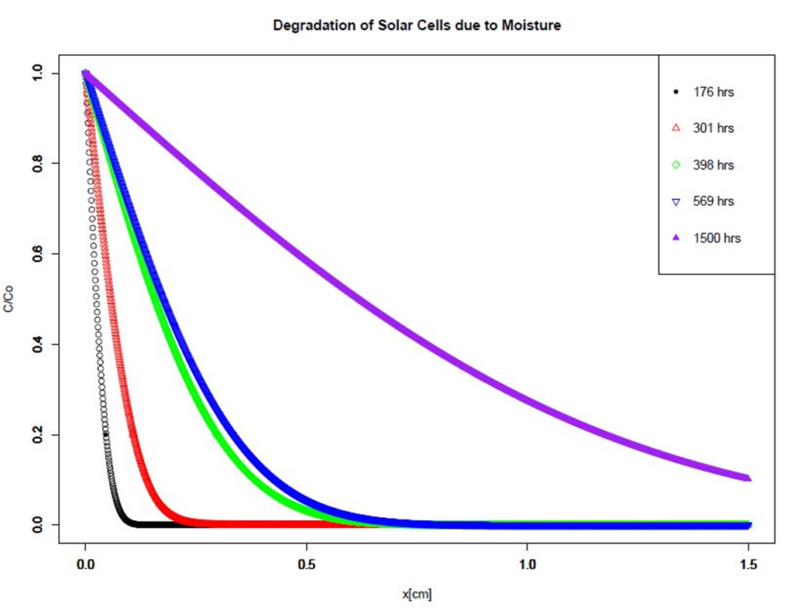
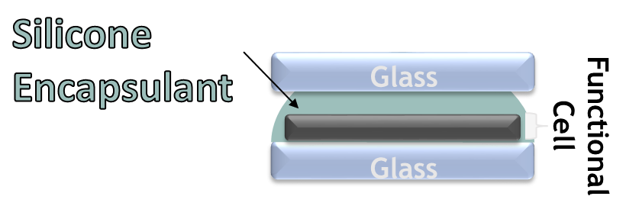
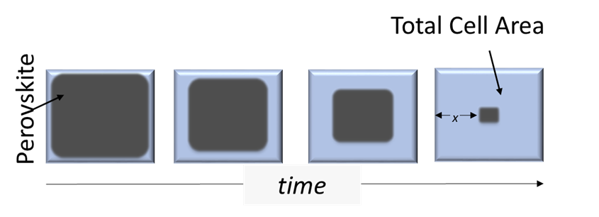
Thermochemical Model

Slide 6
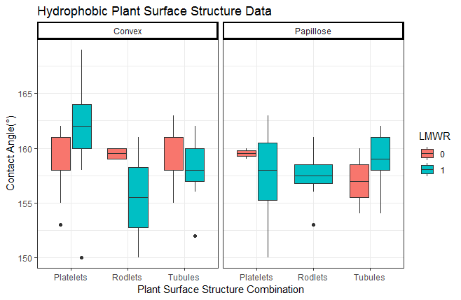
Hydrophobic Plant Structures

Slide 7
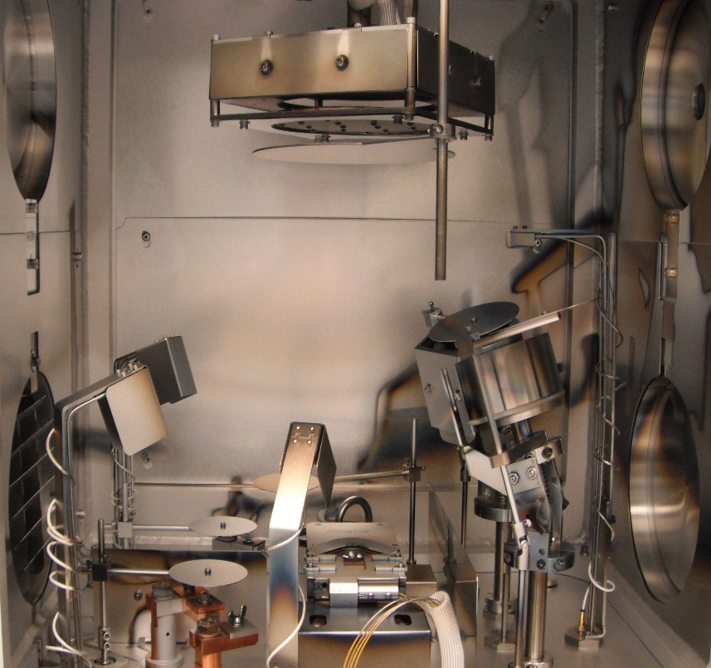
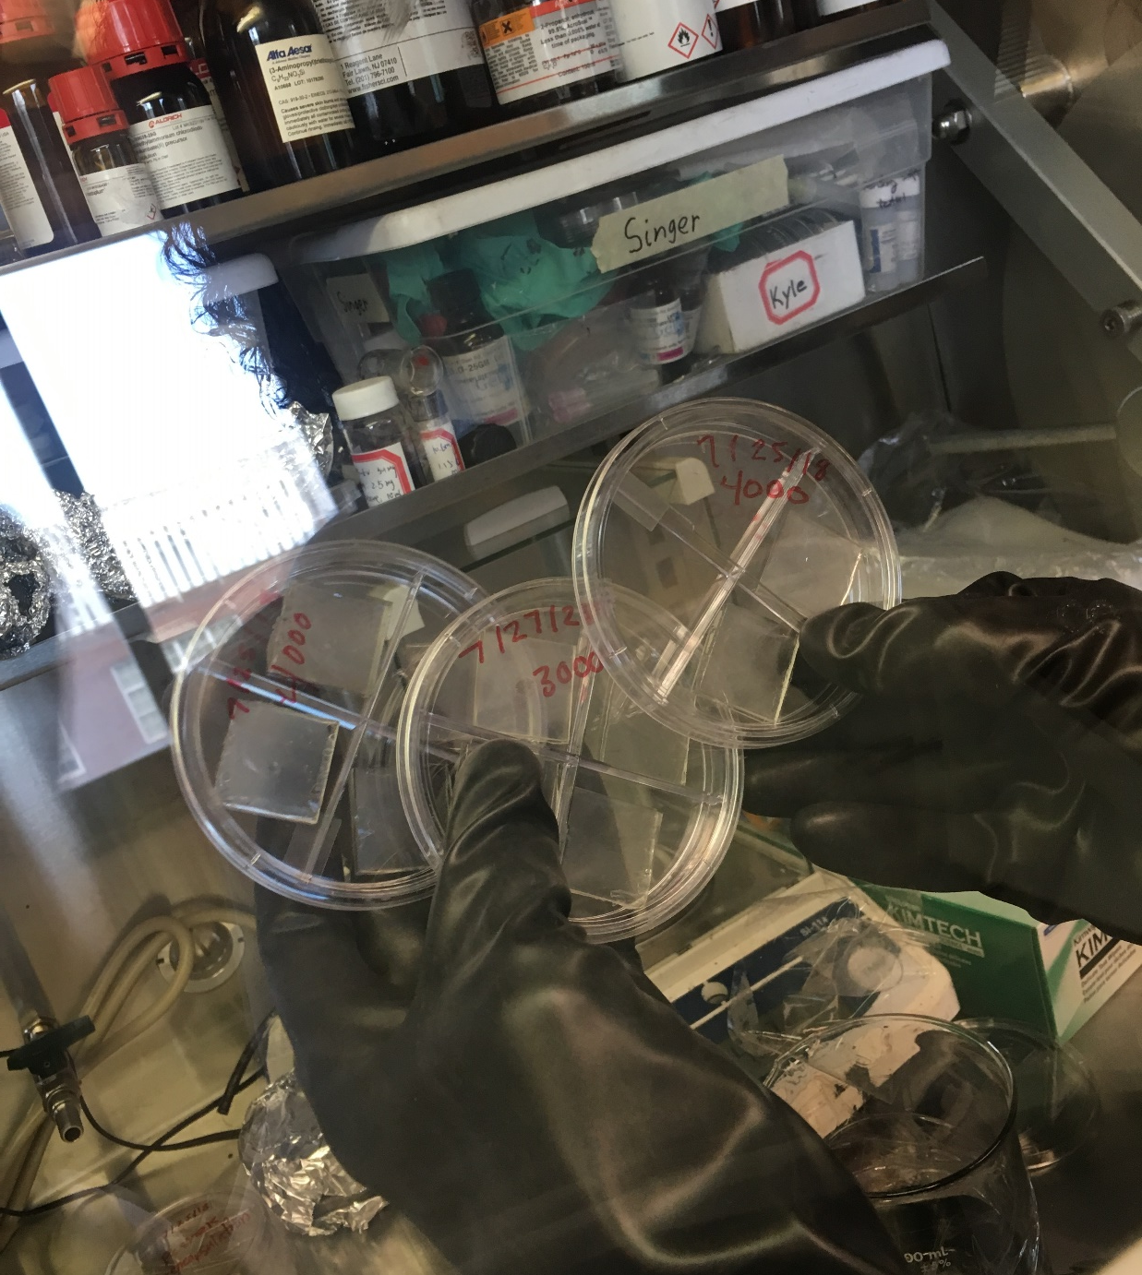
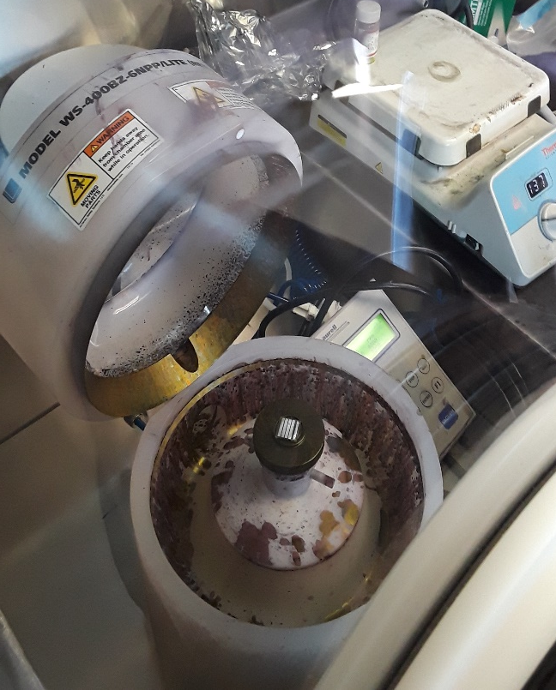
Experimental Methods
Perovskite Deposition
Protective Layer Deposition
Experimental Test “Cells”
Notes:
Protective layers informed through the through simulations and data analysis are tested experimentally. Here is where we actualize our theories and determine if they work in real life. Additionally, we are able to speculate on what
determine if the theories work in real life, and determine what protections are worth further research.

Slide 8
Summary/Acknowledgemnts
Ultimately, Perovskite Solar Cells are worth further research and review
Especially for Solar Electric Propulsion lol
We Would like to thank/acknowledge
Dr. Peshek
Space Academy
Ohio Space Grant

Slide 9
Thank You

